Slide 1
Generation Of Computer And Quantum Computer

Slide 2
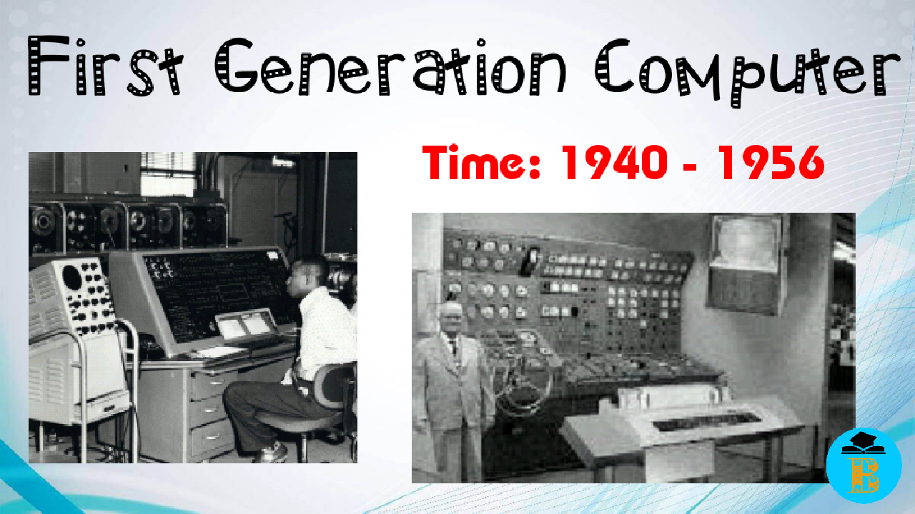
First Generation Of Computer
The first generation laptop was ENIAC (Electronic Numerical Integrator and Calculator). It had been the primary all-purpose electronic computer that is intended by William Mauchly and John Eckert in 1942. However, the machine was completed in 1945

Slide 3
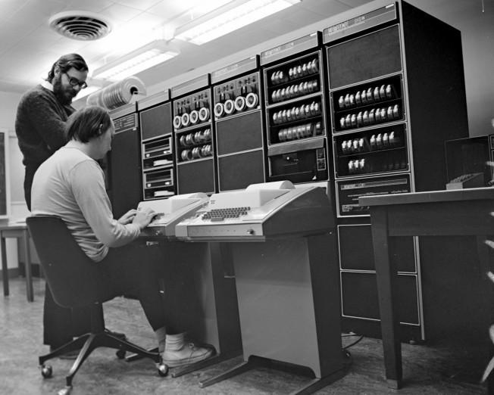
Second generation of computer
A transistor computer, now often called a second generation computer, is a computer which uses discrete transistors instead of vacuum tubes. The first generation of electronic computers used vacuum tubes, which generated large amounts of heat, were bulky and unreliable.

Slide 4
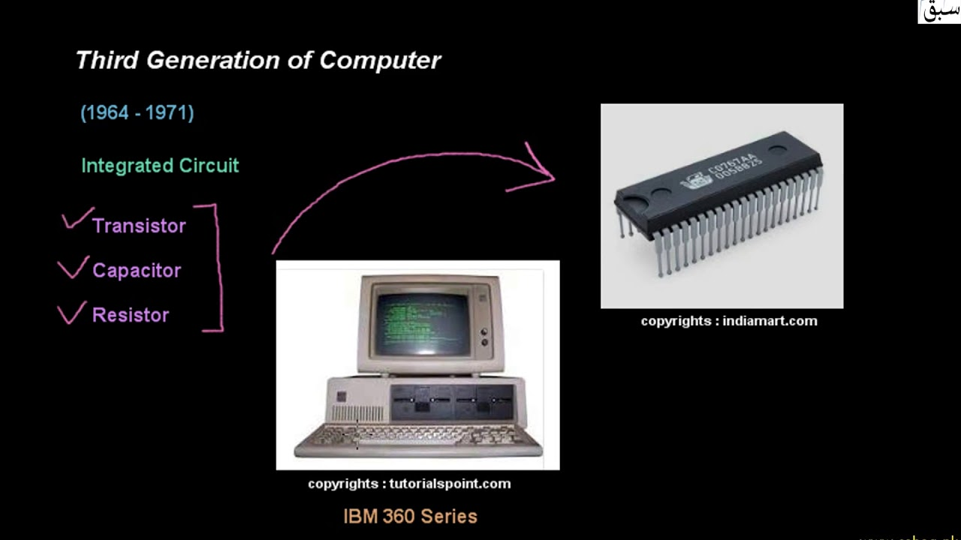
Third generation of computer
The period of third generation was from 1965-1971. The computers of third generation used Integrated Circuits (ICs) in place of transistors. This development made computers smaller in size, reliable, and efficient. In this generation remote processing, time-sharing, multiprogramming operating system were used.

Slide 5
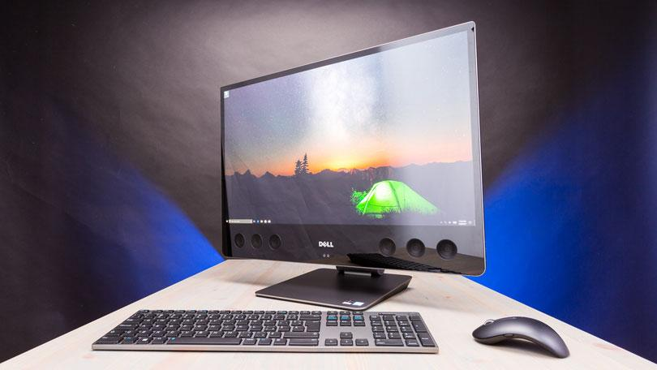
Forth generation of computer
Fourth Generation of computers was between 1971 – 1980. These computers used the VLSI technology or the Very Large Scale Integrated (VLSI) circuits technology. Therefore they were also known as the microprocessors. Intel was the first company to develop a microprocessor.

Slide 6
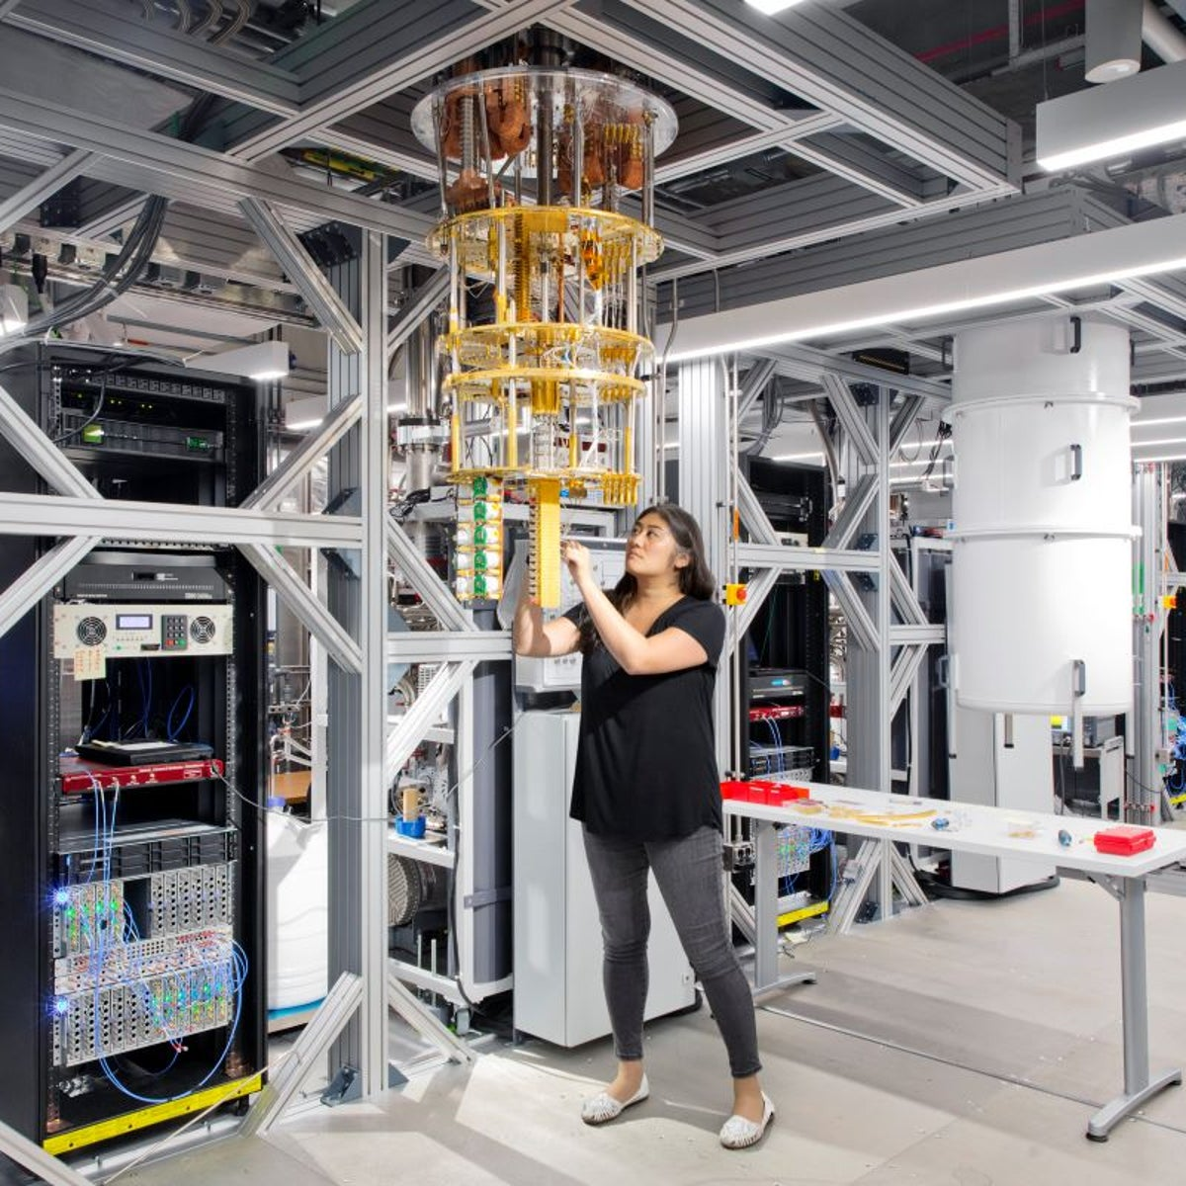
Quantum Computer
Quantum computers are machines that use the properties of quantum physics to store data and perform computations. ... Classical computers, which include smartphones and laptops, encode information in binary “bits” that can either be 0s or 1s. In a quantum computer, the basic unit of memory is a quantum bit or qubit.

